Slide 1
Group 8
MILKTEA MANAGEMENT
Instructor: Teacher Trịnh Phước Thuận
Members: Nguyễn Văn Dũng
Lê Thị Hương Lài

Slide 2
CONTENT
DIAGRAM
SOME MAIN FUNCTIONS
SOMES PROCEDURES
SOME DISPLAYS
DEMO

Slide 3
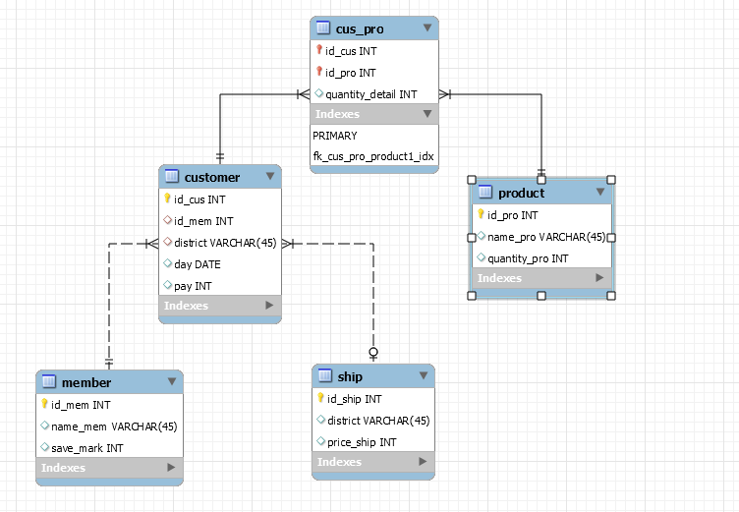
DIAGRAM

Slide 4

FUNCTIONS
SELECT SUM(quantity_detail) INTO quantity_result
FROM cus_pro
WHERE cus_pro.id_cus = id_cus_in;
SET pay_pro = quantity_result * 15000;
Count quantity products and calculate money in a order

Slide 5
SET pay_total = pay_pro + pay_ship - pay_sale;
UPDATE customer
SET pay = pay_total
WHERE id_cus = id_cus_in;
Calculate total money which customer have to pay.
Update customer table.

Slide 6
OPEN pro_update;
FETCH pro_update INTO id_cus2, id_pro2, quantity_detail2;
WHILE no_more_product2 !=1 DO
BEGIN
IF id_cus2 = id_cus_in THEN UPDATE product SET quantity_pro = quantity_pro - quantity_detail2 WHERE id_pro = id_pro2; END IF;
END;
FETCH pro_update INTO id_cus2, id_pro2, quantity_detail2;
END WHILE;
CLOSE pro_update;
END $$
Update product quantity after customer bought.
6

Slide 7
UPDATE member, customer
SET save_mark = (save_mark_variable + quantity_result)%10
WHERE customer.id_cus = id_cus_in
AND customer.id_mem = member.id_mem;
Update save mark in member table
7

Slide 8
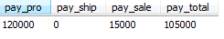
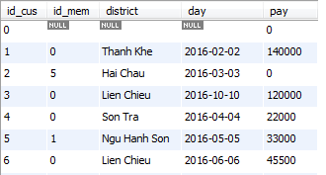
Procedures
Procedure calculate money which customer have to pay

Slide 9
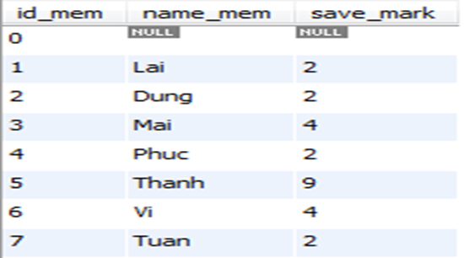
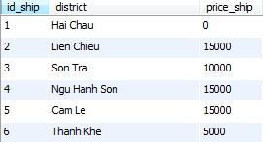
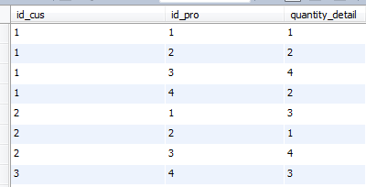

Slide 10
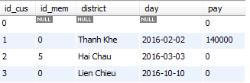
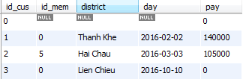
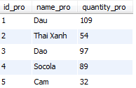
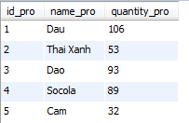
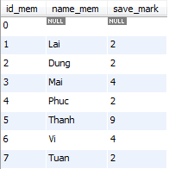
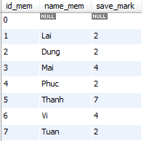
Update

Slide 11
DELIMITER $$
CREATE PROCEDURE calculateMoneyInAMonth
(IN yearInput VARCHAR(4), IN monthInput VARCHAR(2))
BEGIN
DECLARE s VARCHAR(20) ;
SET s = CONCAT(yearInput,'-',monthInput,'-%');
SELECT SUM(pay)
FROM customer
WHERE day LIKE s;
END $$
DELIMITER ;
CALL calculateMoneyInAMonth(‘2016’,’10’);
Procedure Calculate sum money in a month

Slide 12
DROP PROCEDURE IF EXISTS calculateMoneyOfMemberBuyMost $$CREATE PROCEDURE calculateMoneyOfMemberBuyMost ()
BEGIN
SELECT id_mem, SUM(pay)
FROM customer
WHERE id_mem!=0
GROUP BY id_mem
ORDER BY SUM(pay) DESC LIMIT 1;
END $$
CALL calculateMoneyOfMemberBuyMost();
Procedure calculate money of member buy most.

Slide 13
DELIMITER $$
DROP PROCEDURE IF EXISTS OrderProductSellMostDesc $$
CREATE PROCEDURE OrderProductSellMostDesc()
BEGIN
SELECT id_pro, SUM(quantity_detail)
FROM cus_pro
GROUP BY id_pro
ORDER BY SUM(quantity_detail) DESC;
END $$
DELIMITER ;
Procedure order product sold most desc

Slide 14
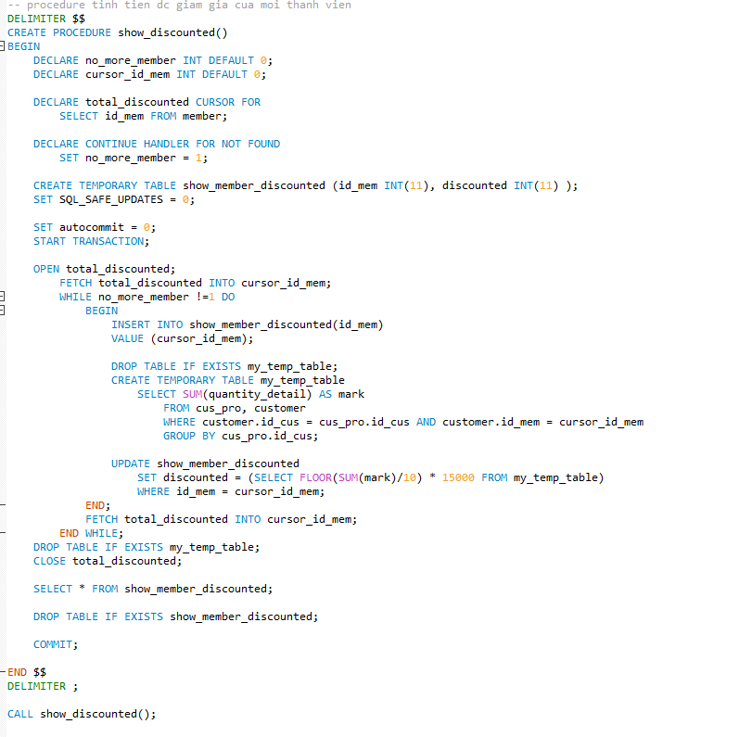
Procedure calculate money which members were discounted

Slide 15
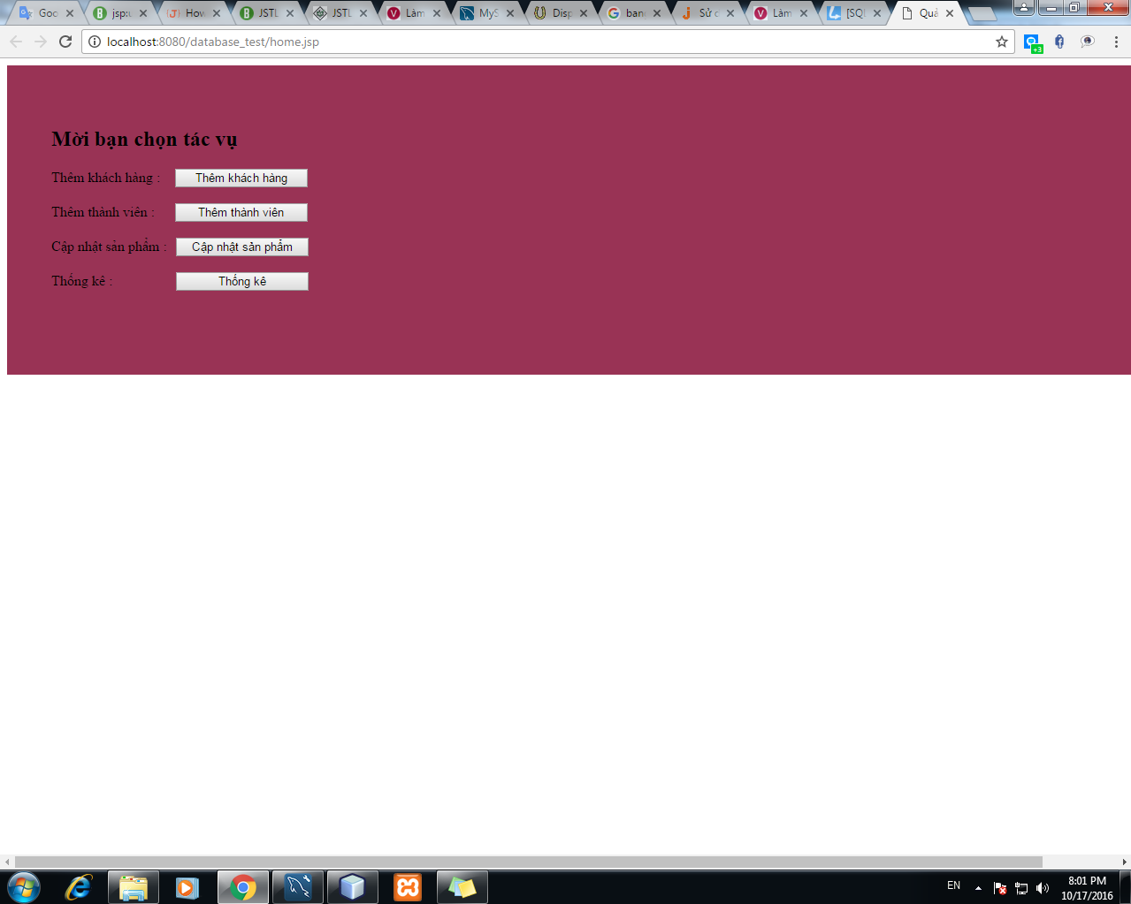
Displays
MAIN PAGE

Slide 16
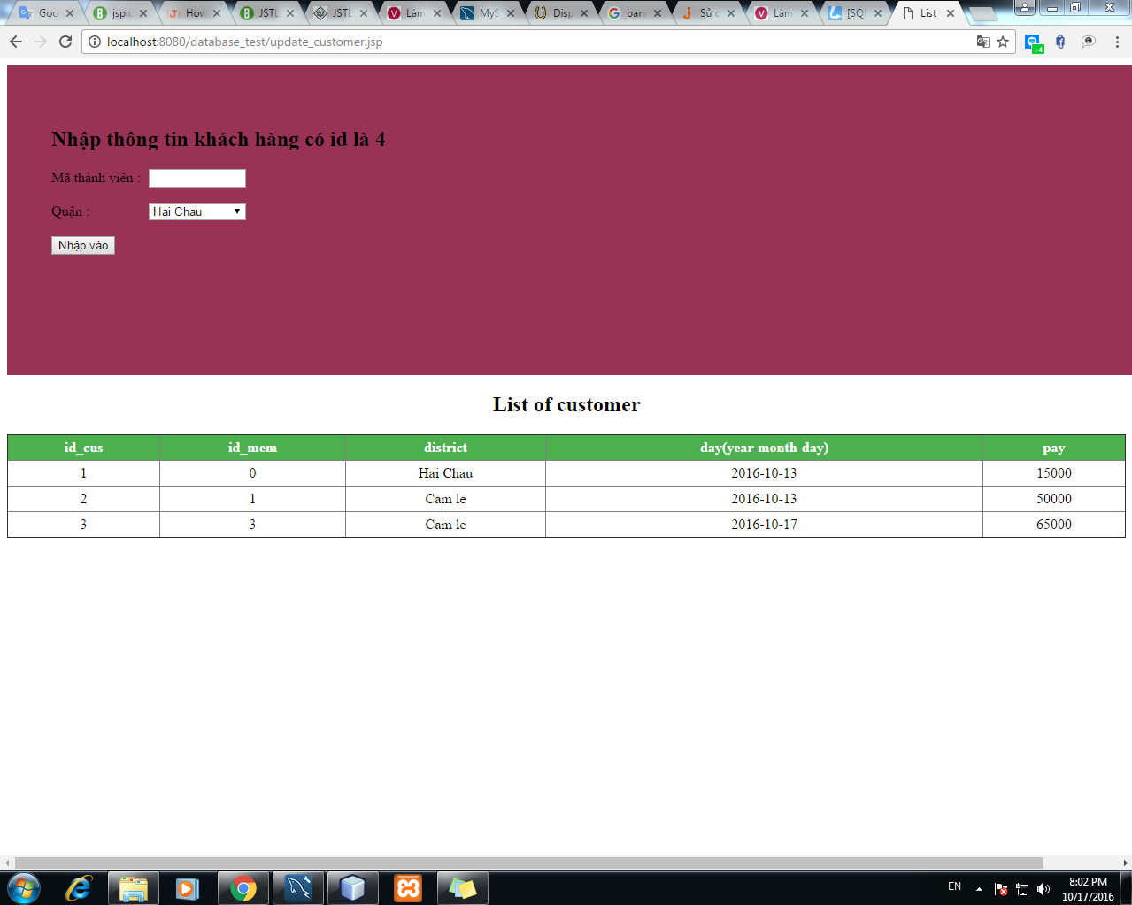
CUSTOMER
PAGE

Slide 17
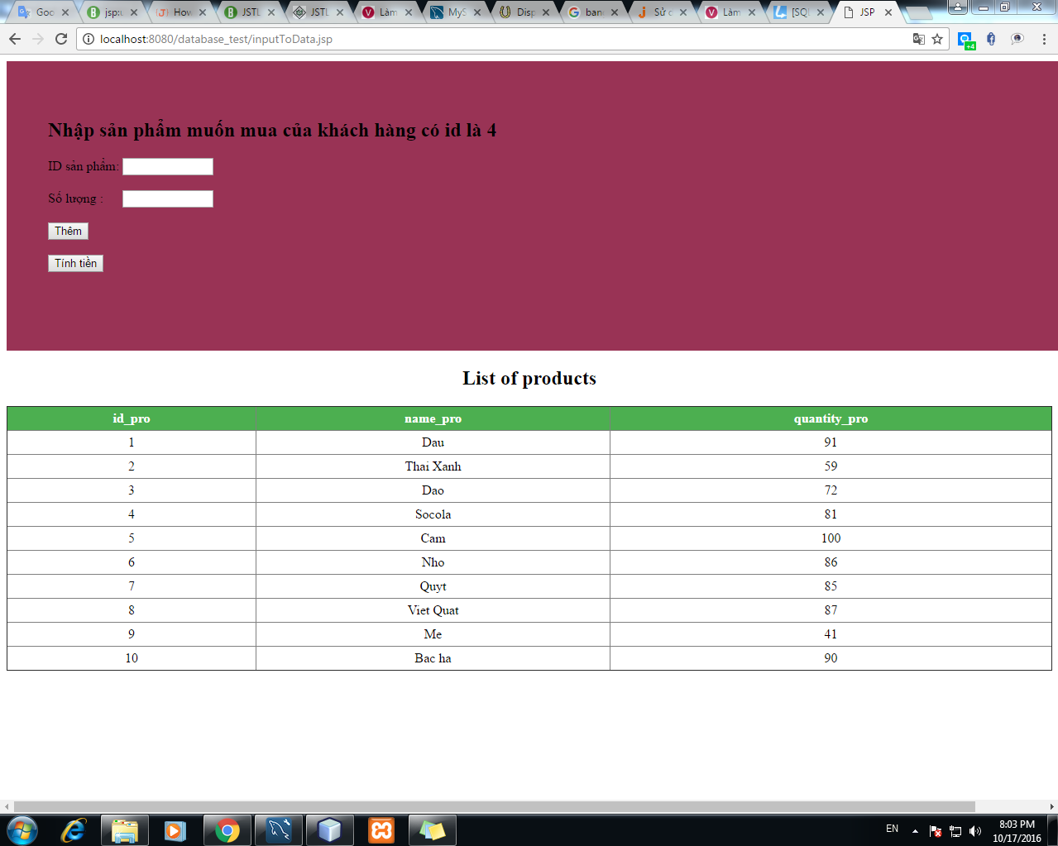
CUSTOMER BUY PRODUCT PAGE

Slide 18
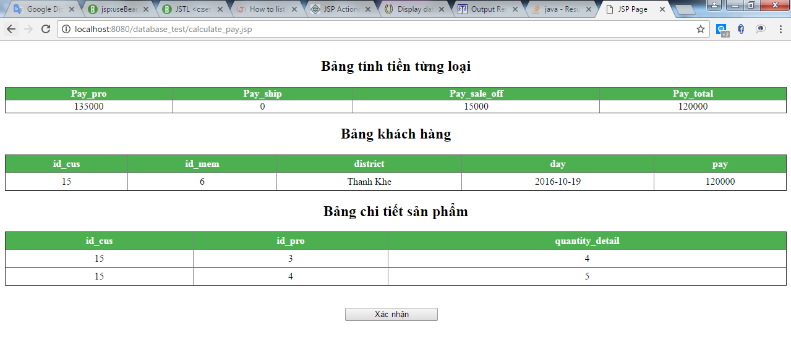
PAYMENT PAGE

Slide 19
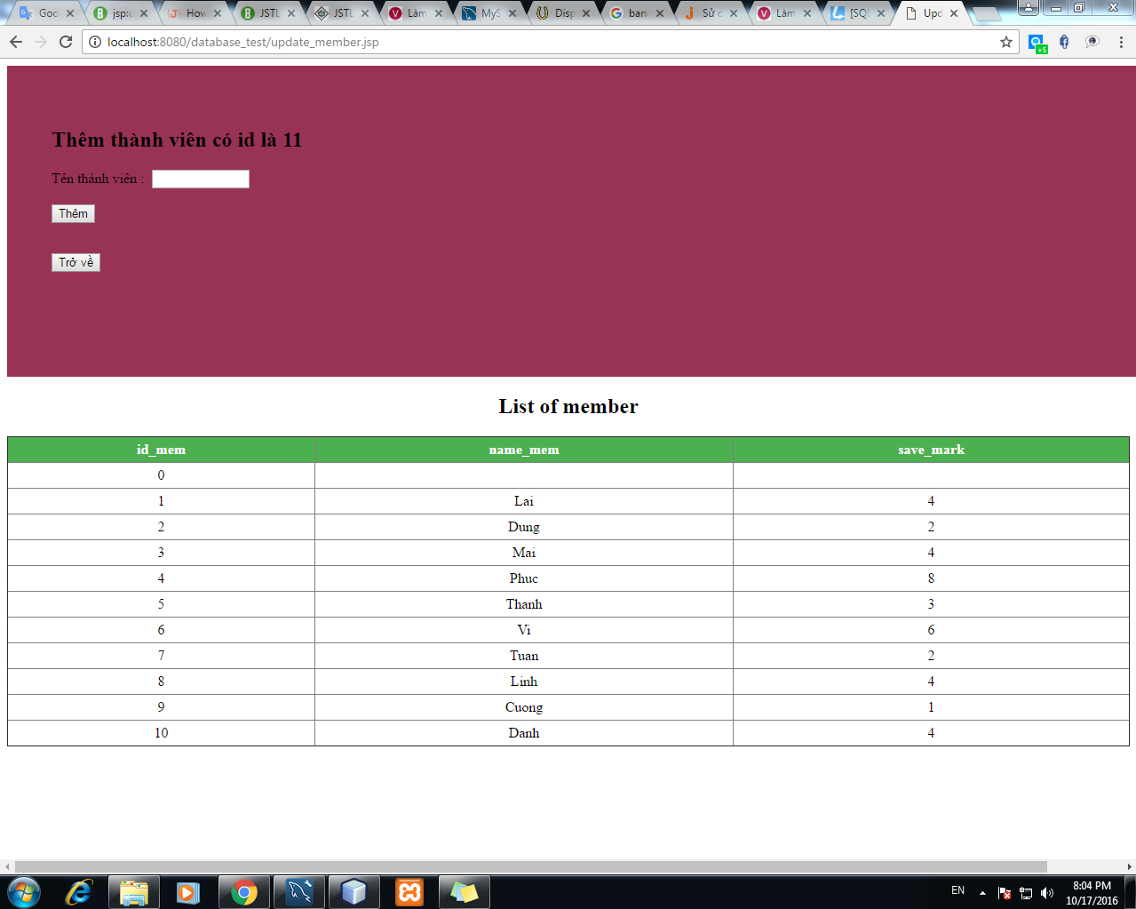
MEMBER PAGE

Slide 20
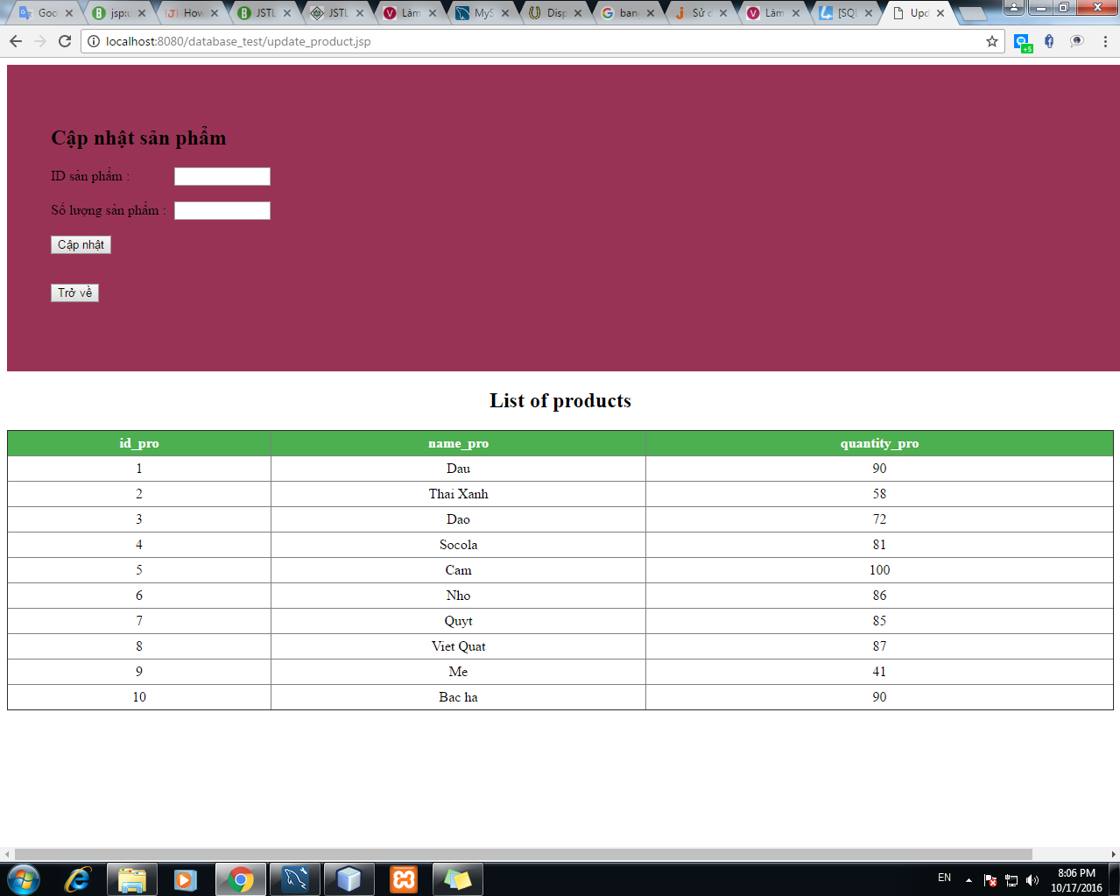
PRODUCT PAGE

Slide 21
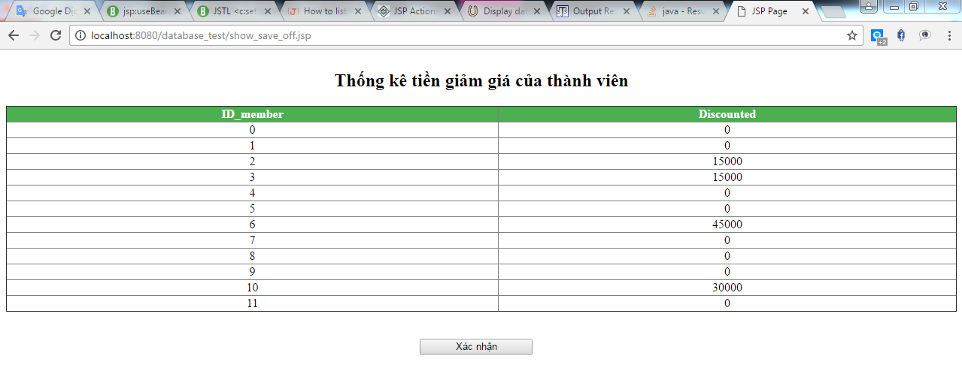
TOTAL DISCOUNT PAGE

Slide 22
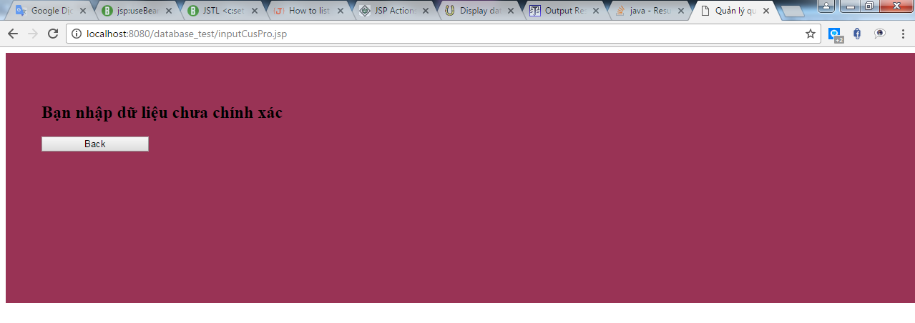
ERROR PAGE

Slide 23

DEMO

Slide 24


